Slide 1

RSNA CERVICAL SPINE FRACTURE DETECTION
INT Internship
Final Review
Member
1.SreelakshmiA(E7321005)
Project Guide
1. Dr. Pitchumani Angayarkanni

Slide 2
Abstract
A fracture in one of the cervical vertebrae Which is commonly called as broken neck. It may also lead to paralysis or even death.
The dataset cervical spine fracture detection is taken from kaggle (WWW.kaggle.com).
The proposed dataset has 7,12,919(dcm) raw CT scans of the cervical spine and annotations of vertebral fractures or abnormalities per vertebral level.
The methodology involves using the custom and pre-trained models such asVgg19, ResNet50 and DenseNet to classify which part of the vertebrae is fractured (C1, C2, C3, C4, C5, C6, C7) and whether the patient has vertebral fracture or not.

Slide 3

Introduction
The neck, also called the cervical spine, is a well engineered structure of bones, nerves, muscles, ligaments, and tendons. The cervical spine is delicate-housing the spinal cord that sends message from the brain to control all the aspects of the body-while also remarkably strong and flexible, allow the neck to move in all directions. The cervical spine has 7 stacked bones called vertebrae, labeled C1 through C7. The top of the cervical spine connects to the skull, and the bottom connects to the upper back at about shoulder level. Cervical fractures usually result from high-energy trauma, such as automobile crashes or falls. In elderly people, ground level falls such as falling from chairs and stairs, can result cervical spine fractures.

Slide 4
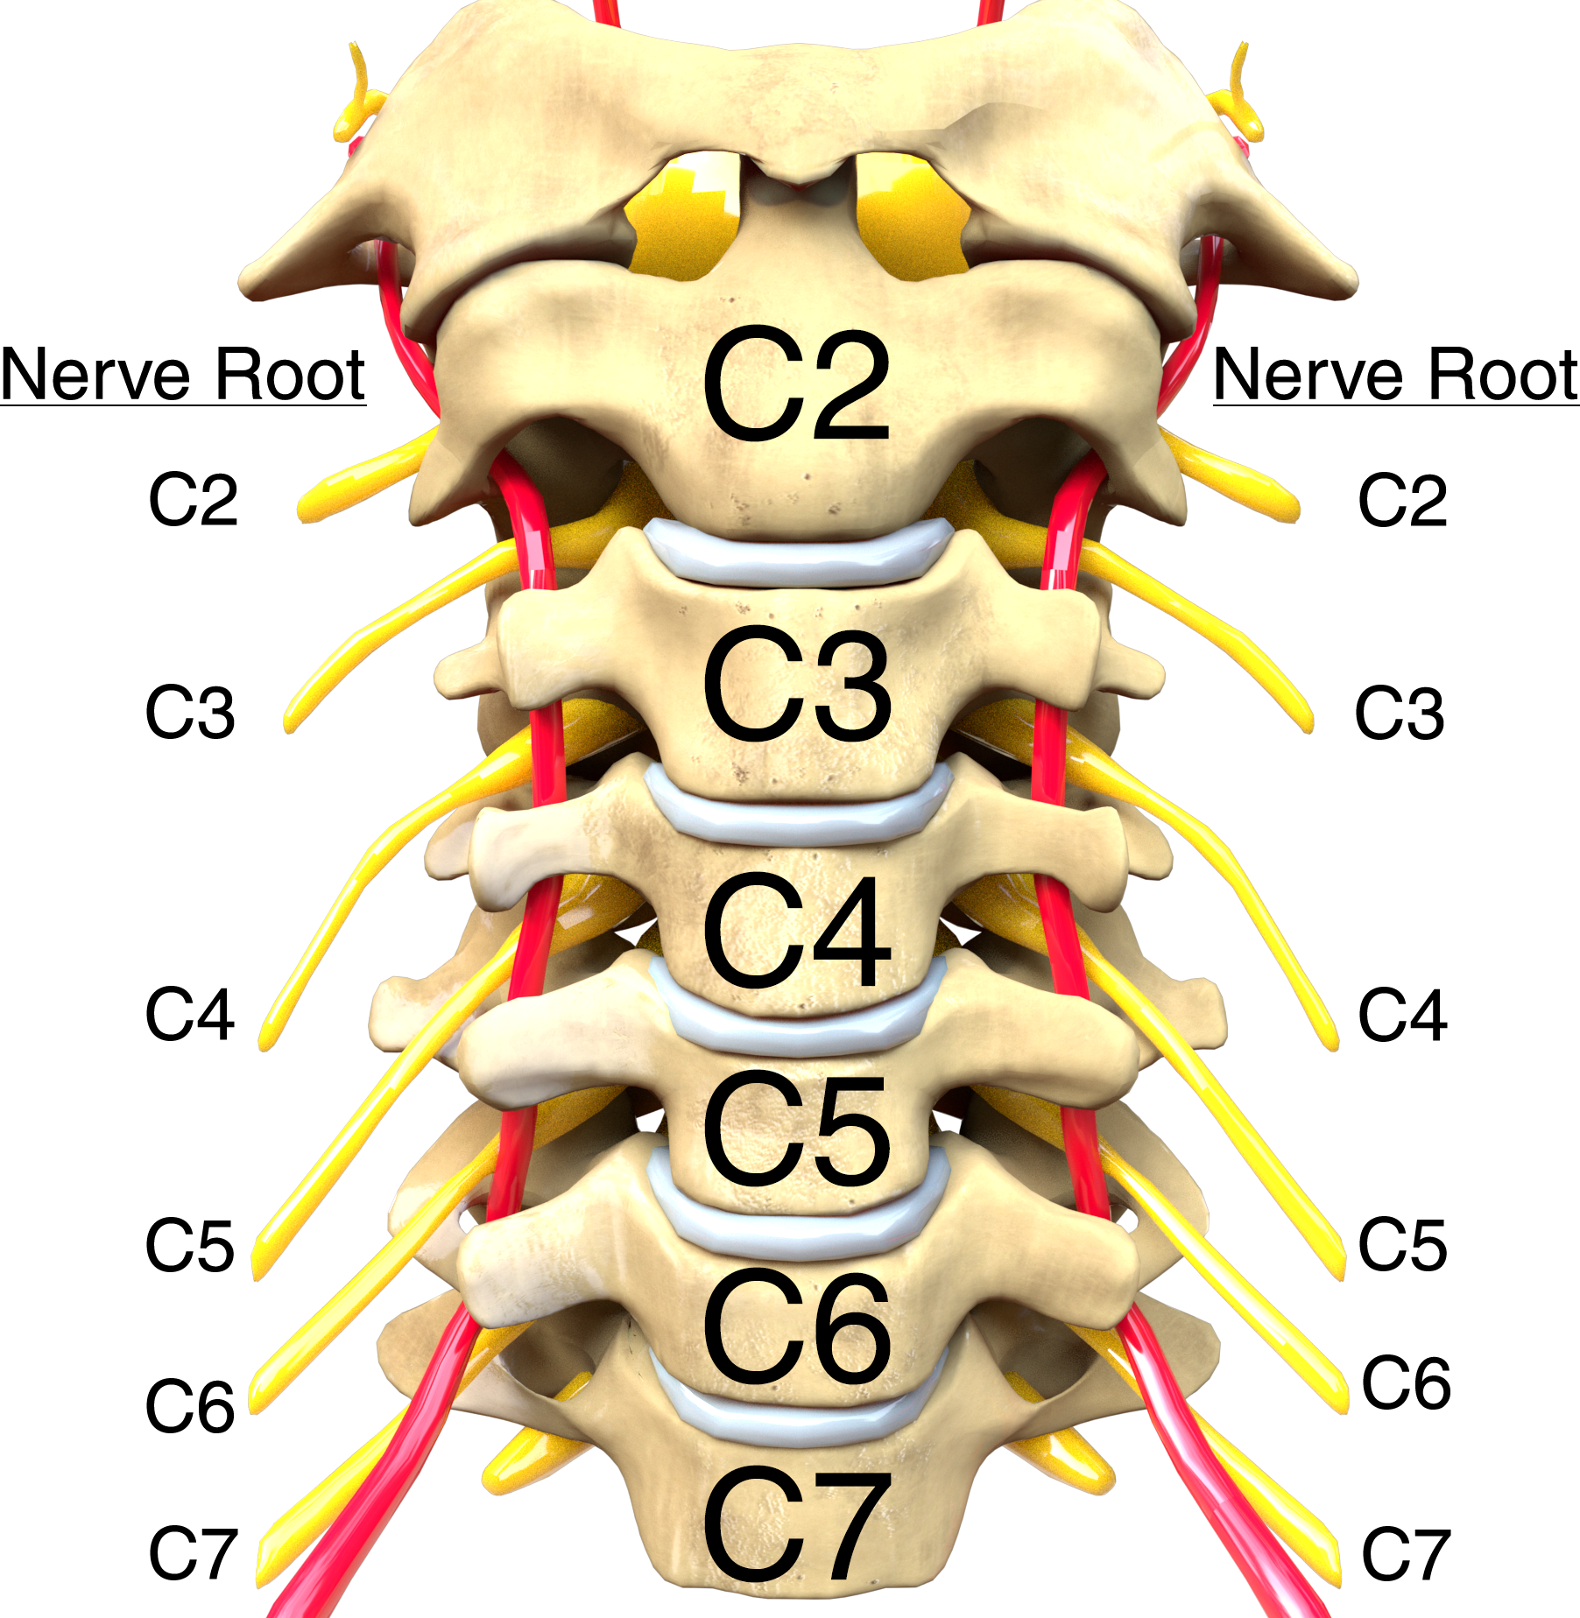
Cervical Spine

Slide 5
Roles of the Cervical Spine
Protecting the spinal cord: The spinal cord is a bundle of nerves that extends from the brain and runs through the cervical spine and thoracic spine(upper and middle back) prior to ending just before the lumbar spine(lower back).Each vertebrae has large hole for the spinal cord to pass through. Together, these vertebrae keep the spinal cord shielded inside a bony tunnel is called the spinal canal.
Supporting the head and its movements: The cervical spine handles the heavy load, as the head weighs over 10 and 13 pounds.In addition to supporting the head, the cervical spine allows the necks flexibility and heads range of motion.
Facilitating flow of blood to the brain: Small holes in the cervical spine provide a passageway for arteries to carry blood to the brain. These openings for the blood vessels are present only in cervical spine from C1 down to C6 (not in C7 or lower).

Slide 6
Movements of the Cervical spine
The cervical spine is the most mobile region of the spine.Head and neck motions typically involve one or more of the following of the cervical spine:
Flexion: The cervical spine bends directly forward with the chin tilting down. Neck flexion typically occurs when looking downward or while in forward head posture, such as when sitting with a poor posture at a computer.
Extension: The cervical spine straightens or moves directly backward with the chin tilting up.Neck extension is common when performing overhead work.
Rotation: The cervical spine and the head turn to one side. Neck rotation is particularly useful when trying to look to the or over the shoulder,such as when backing up a car.
Lateral Flexion: The cervical spine bends to one side with the ear moving toward the shoulder.

Slide 7
Context and Problem statement
RSNA (Radiological Society of North America) Cervical Spine Fracture refers to a project or initiative by the Radiological Society of North America to study and improve the detection of cervical spine fractures through the use of medical imaging and machine learning.
RSNA cervical spine fracture projects typically involve the use of large datasets of medical images, such as X-rays, CT scans, or MRI scans, to train machine learning models. These models are then tested and evaluated on a separate set of images to determine their accuracy and reliability in detecting cervical fractures.
Problem Statement:
The goal of this initiative is to develop and validate accurate and efficient methods for detecting cervical fractures, which can help improve patient outcomes and reduce the risk of long-term complications.

Slide 8
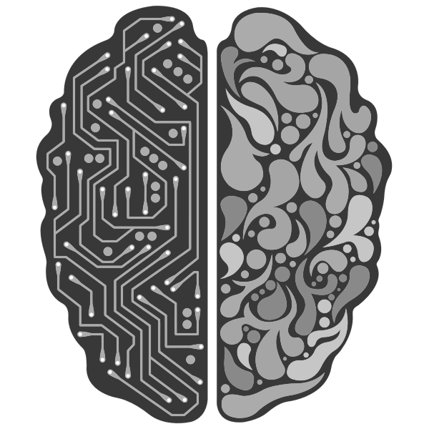
Objective:
The objective of this study is to develop a machine learning model in Python to accurately detect cervical spine is fractured or not. The dataset used in this study consisted of X-ray images of cervical spine fractures and normal cervical spines. The images were pre-processed and labeled to create a training and testing dataset for the machine learning model. Fractures in X-ray images. we used a Convolutional Neural Network (CNN) to detect the cervical vertebrae from the images. The CNN model then was tested on a dataset of different types of images. The output layer then predicts whether the input image contains a fracture or not.

Slide 9
Review of related Literature/Product survey
NAME | APPLICATION | TECHNIQUES USED | RESULTS
PAPER 1: http://dx.doi.org/10.3174/ajnr.A7094 Juan Small Polina Osler Aaron Paul Mara Kunst Published: July 2021 | CT Cervical Spine Fracture Detection Using a Convolutional Neural Network | Machine Learning Deep Learning Convolutional Neural Network (CNN) | The sensitivity of the CNN (79%) is lower than that of the radiologists (93%). CNN output should therefore be appraised after the radiologist’s imaging review.
PAPER 2: https://www.researchgate.net/publication/344894435 Edward Ho Suradech Suthiphosuwan Priscila Crivellaro PUBLISHED: 20 April 2021. | Deep Sequential Learning for Cervical Spine Fracture Detection on Computed Tomography Imaging | Machine Learning Deep Learning ResNet-50 ResNet-101 Deep Convolutional Neural Network (DCNN) BLSTM | The results show 80.01% and 77.61% classification accuracy for the imbalanced and balanced datasets. The accuracy is approximately 71% for the balanced dataset and it is less dependent on the number of LSTM units.
PAPER 3: Sung Hye Kong Jae-Won Lee Byeong Uk Bae Jin Kyeong Sung PUBLISHED: 26 May 2022 | Development of a Spine X-Ray-Based Fracture Prediction Model Using a Deep Learning Algorithm | Machine Learning Deep Learning Convolutional Neural Network Statistical Analysis | Trained CNN models with patches from localized and segmented images of vertebrae, achieving an accuracy of 89% to 90%

Slide 10
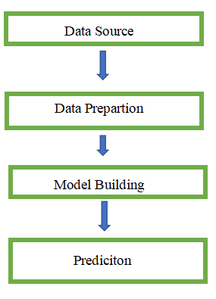
Proposed Architecture
Data Source:
Source - RSNA / KAGGLE
RSNA cervical spine fracture projects typically involve the use of large datasets of medical images, such as X-rays, CT scans, or MRI scans, to train machine learning models. These models are then tested and evaluated on a separate set of images to determine their accuracy and reliability in detecting cervical fractures.
Data preparation is the process of organizing, cleaning, and structuring data to make it suitable for analysis.
Model Building Involves model selection, training & Evaluation
Prediction is the forecasted result of the RSNA dataset, i.e. Whether the patient’s spine is fractured or not using the trained CT scan images.

Slide 11
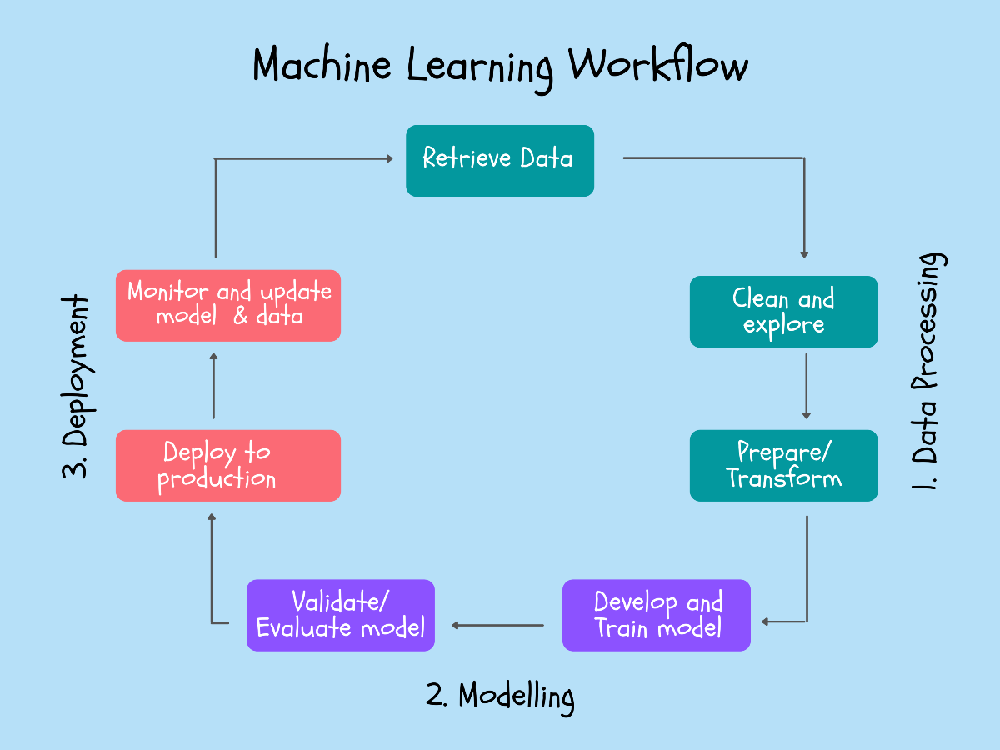
Work Flow/Methodology

Slide 12
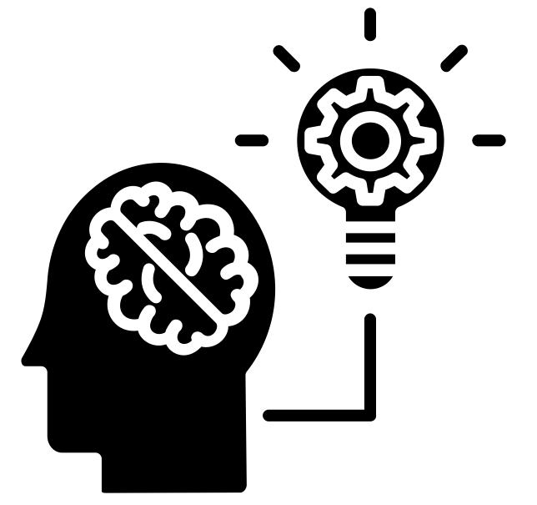
Data Preparation:
Data preparation is the process of organizing, cleaning, and structuring data
to make it suitable for analysis. It is a key step in the data science process, as
it ensures the data is reliable and accurate and enables more complex analysis
to be performed. Data preparation involves such activities as data cleansing, data
integration, and data transformation. Data cleansing involves identifying and
removing inconsistencies and outliers, while data integration involves combining
data from different sources. Data transformation is the process of converting data
into a format that is suitable for analysis

Slide 13
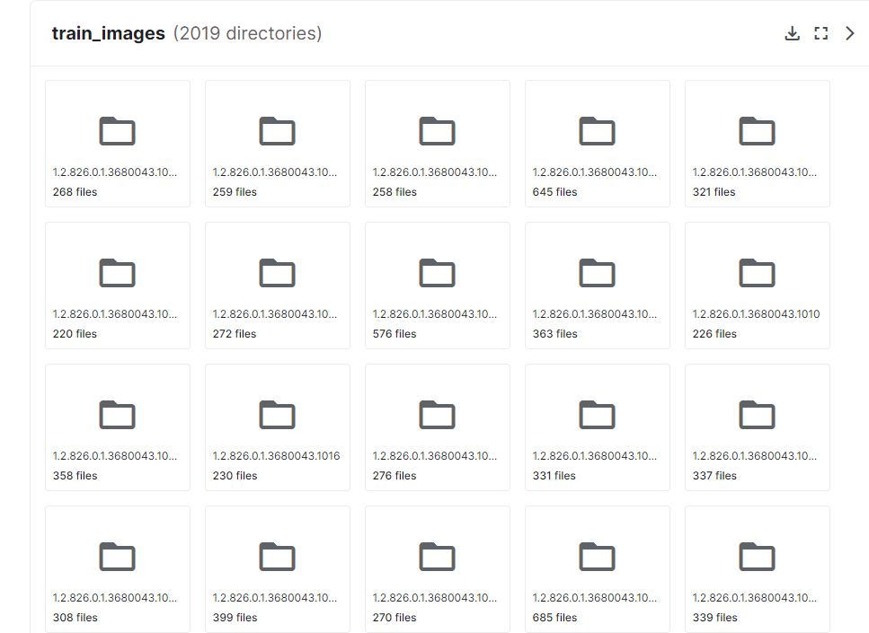
Data Preprocessing:
Analysing the RSNA CT scans it contains patients CT scans folders with the images.
Two folders found :
Train_images
Test_images
Train_images folders:
It contains all the CT scans of the patients (fractured and not fractured).
As we need to have only the categorical classes for the Model building. Here we have a folder with sub-folder in that we have patients images.
In one of the patient’s sub-folder:

Slide 14
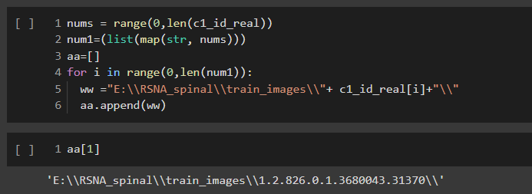
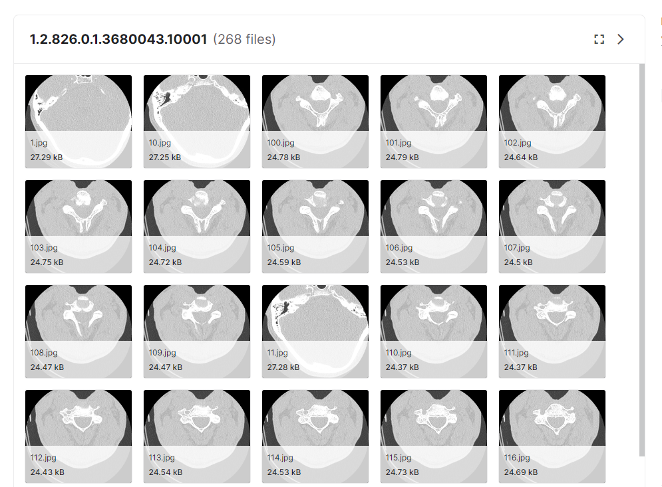
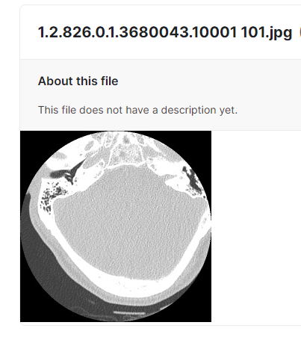
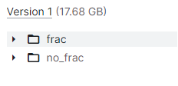
But the template we need is two folders named Train_images and Test_images in that we need two sub-folders each which is frac (Fractured) and no_frac(Not Fractured) which contains CT scans of the patients.
By using pathlib library in python , separating the fractured folders in the train image and test images s by comparing the patients id in the csv file attached in the data source.
Now we have an clean dataset for modelling

Slide 15
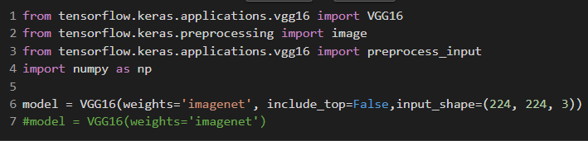
Model Building
The best model for X-ray images depends on various factors such as the type of X-ray image, the problem being solved (e.g. classification or segmentation), and the available data.
For instance, convolutional neural network (CNN) are commonly used in medical image analysis, including X-ray images. Popular CNN architectures include VGG16, ResNet, Inception, and DenseNet.
Transfer learning, where a pre-trained model is fine-tuned on a new dataset, is often used in X-ray image analysis due to the limited amount of annotated data in medical imaging.
In addition to CNNs, other deep learning models such as Generative Adversarial Networks (GANs) and Recurrent Neural Networks (RNNs) have also been applied to X-ray image analysis.
Ultimately, the best model for X-ray images will depend on the specific problem and data, and may require experimentation and testing of different models to determine the optimal solution.

Slide 16
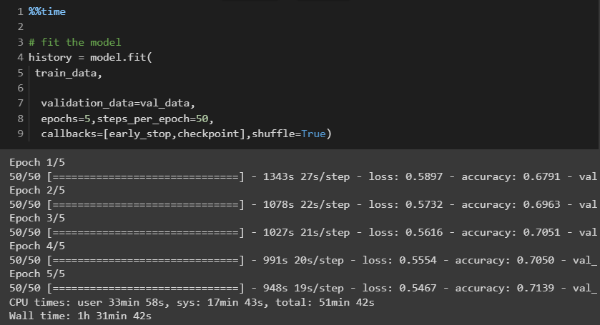
MODEL TRAINING:
Load the pre-trained model and freeze the layers. Replace the fully connected layer with a new layer that fits the number of classes in the new dataset.
Compile the model with an appropriate loss function and optimizer.
Train the model on the new dataset using a suitable batch size and number of epochs.
Evaluate the model on a validation set to assess its accuracy.
Here is a simple example of how the code might look like in Keras (a high-level neural networks API written in Python).
Model Evaluation:
Evaluate the performance of the trained model on the test data to determine its accuracy and reliability in detecting cervical fractures.

Slide 17
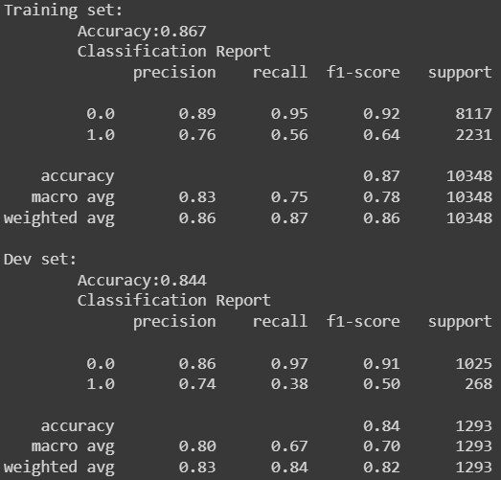
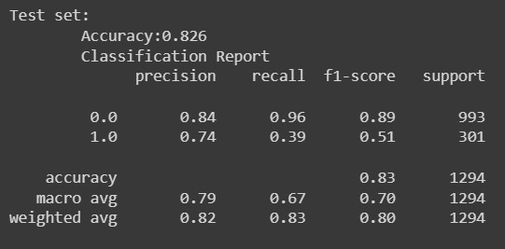
Results & discussion
The results of the study showed that the CNN
model was able to accurately detect cervical
spine fractures in X-ray images. The model
achieved an accuracy of 83%, sensitivity of
87.4%, and specificity of 84.1%.

Slide 18
Main Contribution
In the model selection stage, different machine learning algorithms are trained and compared to select the best-performing model. Finally, in the evaluation stage, the selected model is tested on a separate dataset of medical images to determine its accuracy and reliability in detecting cervical fractures.
The RSNA cervical spine fracture detection project is important because it brings together experts in medical imaging, machine learning, and radiology to address a real-world clinical problem. The results of this research can be used to improve patient care and help to reduce the risk of long-term complications associated with cervical fractures.

Slide 19

Future Research
Fine tuning with large number of data .
After getting the best accuracy metrics deploy it in a web services.

Slide 20
REFERENCES:
Adams M, Chen W, Holcdorf D, et al. Computer vs human: Deep learning versus perceptual training for the detection of neck of femur fractures. J Med Imaging Radiat Oncol 2019;63:27–32 CrossRef Medline
Urakawa T, Tanaka Y, Goto S, et al. Detecting intertrochanteric hip fractures with orthopedist-level accuracy using a deep convolutional neural network. Skeletal Radiol 2019;48:239–44 CrossRef Medline
Stewart B Dunsker, Michael Zhang, Lily Kim, Robin Cheong, Ben Cohen-Wang, Katie Shpanskaya, Jessica Wetstone, Nidhi Manoj, Pranav Rajpurkar, and Kristen Yeom, “Deep-learning artificial intelligence model for automated detection of cervical spine fracture on computed tomography (ct) imaging,” in Journal of Neurosurgery, 2019, vol. 131.
John H Bland and Dallas R Boushey, “Anatomy and physiology of the cervical spine,” in Seminars in arthritis and rheumatism. Elsevier, 1990, vol. 20, pp. 1–20
Tran O, Silverman S, Xu X, Bonafede M, Fox K, McDermott M, et al. Long-term direct and indirect economic burden associated with osteoporotic fracture in US postmenopausal women. Osteoporos Int 2021;32:1195-205.
Williams SA, Daigle SG, Weiss R, Wang Y, Arora T, Curtis JR. Economic burden of osteoporosis-related fractures in the US Medicare population. Ann Pharmacother 2021;55:821- 9

Slide 21
Conclusion:
The results of this study demonstrate the potential of machine learning in improving the accuracy and efficiency of cervical spine fracture detection in X-ray images. The CNN model developed in this study has the potential to significantly improve the efficiency and accuracy of cervical spine fracture detection, which can lead to better patient outcomes

Slide 22
Thank you

